Slide 1


Mid defense Final Year Project
Supervisor: A.P Zakriya Jamali
Co-Supervisor: Dr. Samar Raza Talpur &
Farhan Ahmed Jamro
Designed By: Dilbar Hussain

Slide 2
Table Of Content
Introduction​
Problem Statement
Software Requirement Specification
​Software Design Specification
Gantt Chart
Literature Review

Slide 3
Early Brain tumor detection Web-based application
Introduction
The project focuses on using Al and advanced imaging to detect brain tumors from MRI or CT scans.
The goal is to enhance early detection, aid in treatment planning, and improve patient outcomes through accurate and efficient tumor detection

Slide 4
Problem Statement
Early Brain Tumor Detection Through Web Based Application

Slide 5
Software Requirement Specification
Purpose of the Document
Intended Audience
Project Scope
Not in Scope
Functional Requirements
Non-Functional

Slide 6
Purpose of the Document
The purpose of this document for the Final Year Project (FYP) is to provide a Software Requirements Specification (SRS) for a web-based Early Brain Tumor detection.
The SRS document outlines the system's scope and defines its boundaries, ensuring that all users/moderators have a clear understanding of the project's objectives.

Slide 7
Intended Audience
The intended audience for this Software Requirements Specification (SRS) document is anyone involved in developing, testing, deploying, and maintaining the web-based Early Brain Tumor Detection System.

Slide 8
Project Scope
The Application facilitates continuous monitoring of tumor growth and changes over time, thereby assisting medical professionals in making informed decisions.
UI, Testing, System Architecture

Slide 9
Not in scope
Integration with any external systems or services not explicitly mentioned in this document.
While early detection is crucial, the actual treatment planning and execution may be beyond the scope of a detection project. This involves decisions about surgery, chemotherapy, radiation therapy, etc.
Implementation of any payment or transaction processing functionality.
Implementation of any social media or external sharing functionality.
Implementation of any data analytics or reporting functionality.

Slide 10
Functional Requirements
User Registration
Login
Upload Image
Detect Brain Tumor

Slide 11
Non-Functional
User-friendly and easy to navigate.
The system shall be designed to protect user data and prevent unauthorized access.
The system shall also have a response time of less than 5 seconds for all user requests.

Slide 12
Software Design Specification
Introduction
Use Case Diagram
Sequence Diagram
Activity Diagram

Slide 13
Purpose Of the SDS
The purpose of this document is to describe the final year project ”Early Brain Tumor Detection Web-Based Application” in detail and a high-level design framework.

Slide 14
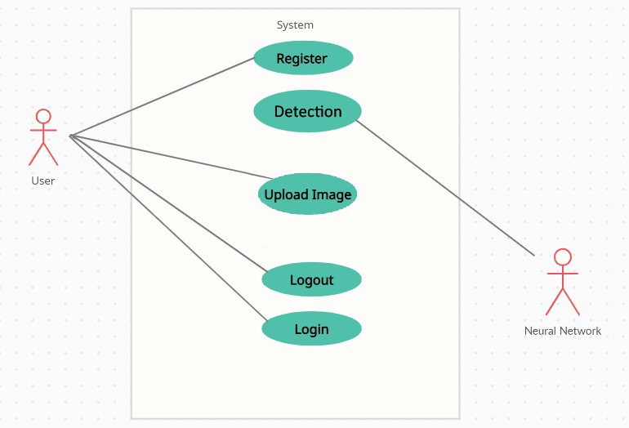
Use Case Diagram

Slide 15
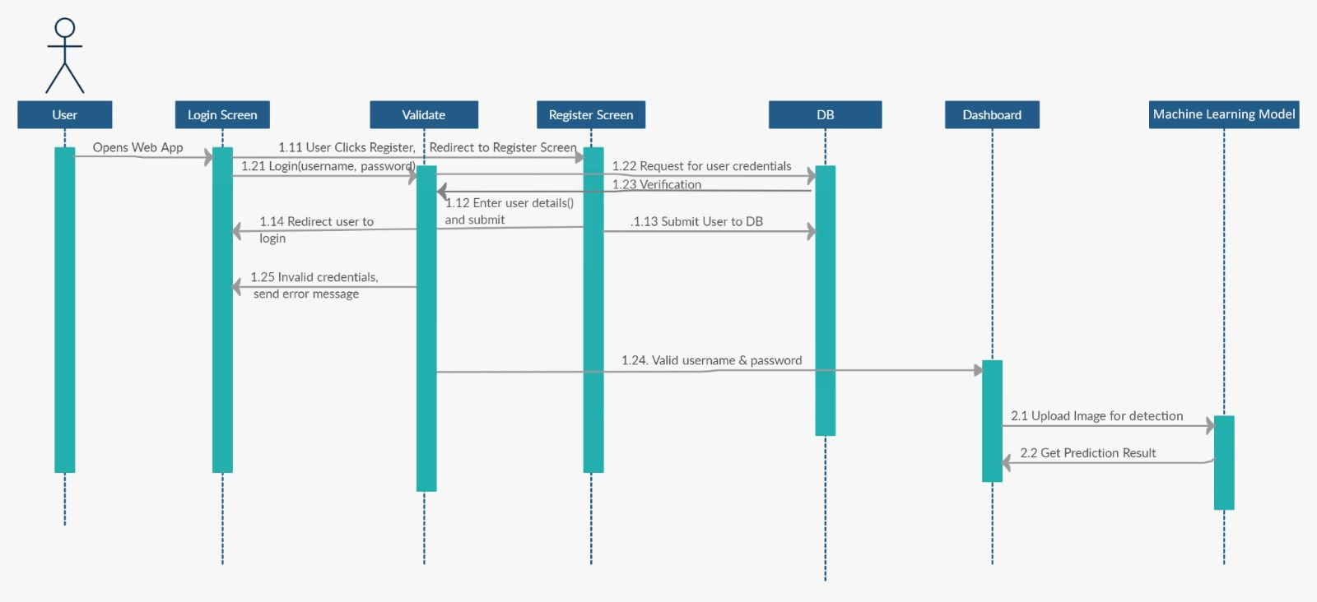
Sequence Diagram

Slide 16
Activity Diagram
Activity Diagram displaced on next slide due to space issue.

Slide 17
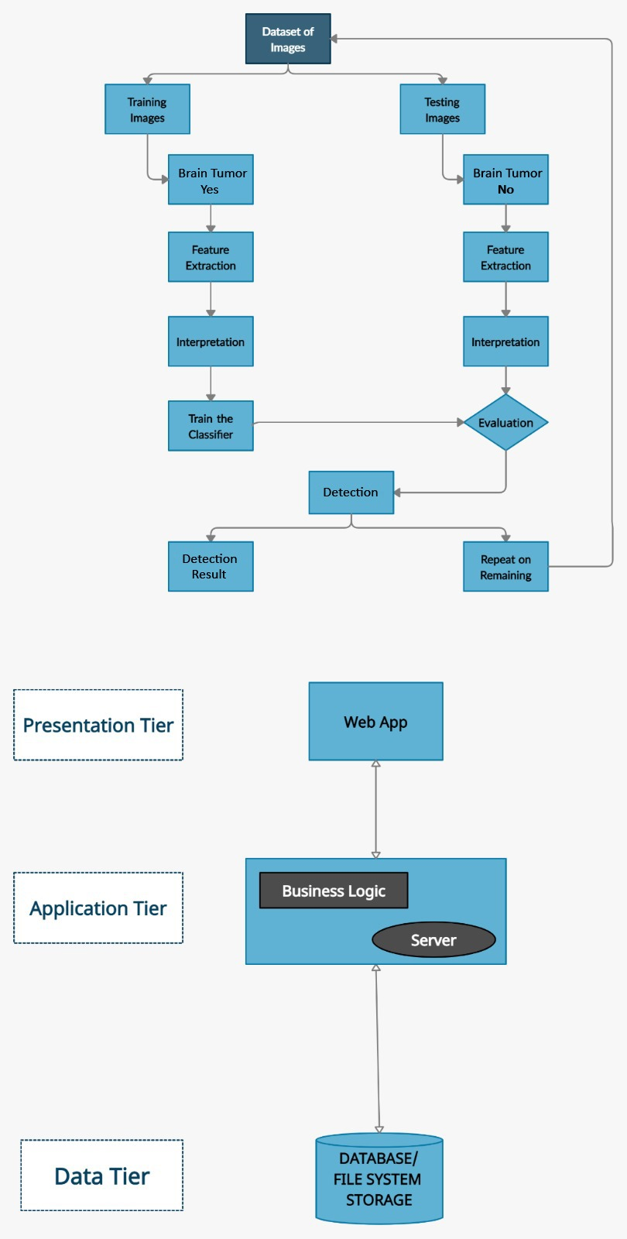

Slide 18
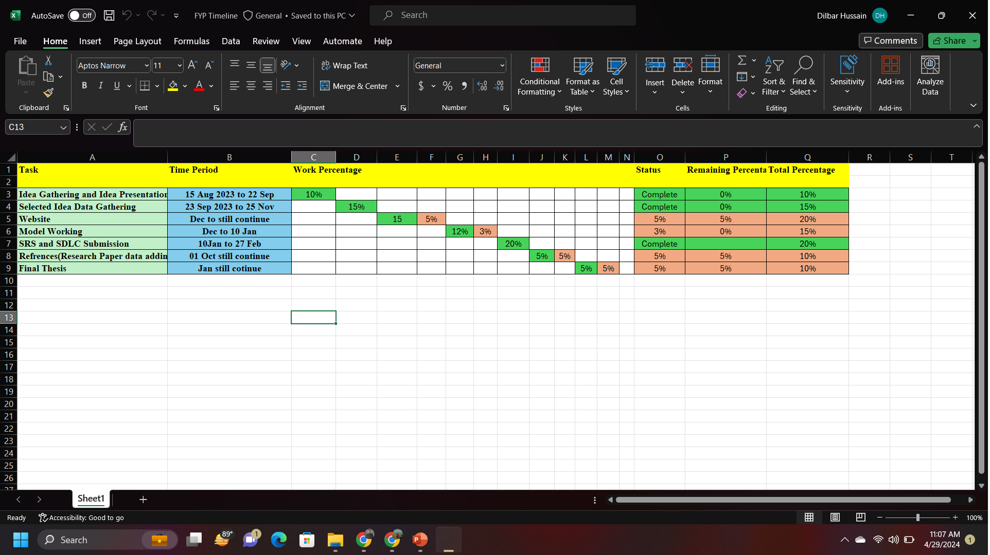
Gantt Chart

Slide 19
Literature Review
Literature | Research Paper Name | Findings/Comments/Limitation
Javeria Amin, Muhammad Sharif | A distinctive approach in brain tumor detection using MRI | Only work on MRI(Magnetic resonance imaging) images. The suggested technique comprises of three major steps that are preprocessing, extraction of features and analysis of detection.
Fairuz Shadmani Shishir, Mohsena Ashraf | Brain Tumor Detection Using Convolutional Neural Network | Segmenting the region of interest from an object is challenging; segmenting a tumor from an MRI Brain image is particularly ambitious. In our approach, we utilize two separate models: one for segmenting the brain region and another for detecting tumors within it.
Chirodip Lodh Choudhury | Brain Tumor Detection and Classification Using Convolutional Neural Network and Deep Neural Network | The proposed method CNN used and implemented using MATLAB. We introduced a model comprising a 3-layered CNN architecture, which would subsequently connect to fully connected neural networks.

Slide 20
THANK YOU

